Slide 1



Smart Buy
Home
Service
About Us
Contact
Search . . . .
Artificial
Intelligence
Smart Buy,
Predicting the prices of used cars accurately using ML models
github.com/chaitaannya/ML_project_-car-price-preidiction-

Slide 2

Smart Buy
Home
Service
About Us
Contact
Search . . . .
About Us
J Chaitanya Sai :A machine learning enthusiast, responsible for model development and fine-tuning to achieve better predictive accuracy
01
Arnav Saxena: A data analyst skilled in preprocessing, cleaning, and feature engineering to prepare high-quality datasets.
02
K Sumith Goud: A front-end developer bringing the project to life by designing an interactive and user-friendly website interface.
03
Your paragraph text

Slide 3

Smart Buy
Home
Service
About Us
Contact
Search . . . .
About Future Technology
Future Technology
The automotive industry is rapidly transforming, driven by emerging technologies like Machine Learning (ML), Artificial Intelligence (AI), and the Internet of Things (IoT). Here's how our project aligns with these advancements:
Enhanced Price Predictions: Future models can incorporate real-time market trends, consumer behavior analytics, and economic indicators for even more accurate predictions.
Personalized Recommendations: With deeper ML integration, platforms could suggest vehicles based on user preferences, driving habits, and budget constraints
Learn More

Slide 4


Smart Buy
Home
Service
About Us
Contact
Search . . . .
Our Project
Data-Driven Insights: Using robust datasets and advanced ML techniques, we provide accurate predictions to aid buyers, sellers, and dealerships in making informed decisions
01
Our project, Car Price Prediction, leverages Machine Learning to estimate the resale value of vehicles based on key factors such as brand, model, year, mileage, engine specifications, and more.
User-Friendly Interface: The project includes a website with an intuitive front-end, ensuring accessibility and seamless user interaction.
02

Slide 5
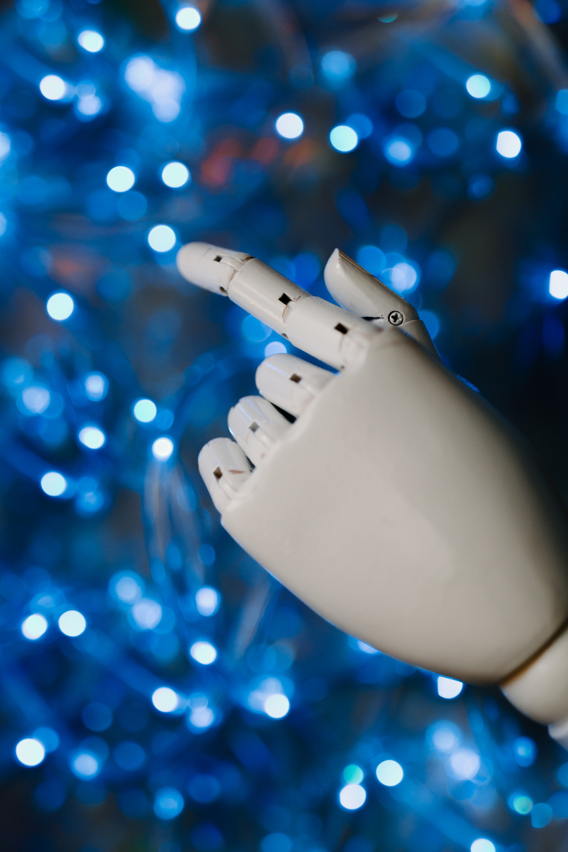
Smart Buy
Home
Service
About Us
Contact
Search . . . .
Technologies used
Python for data preprocessing, feature engineering, and model development.
Scikit-learn and other ML libraries for training and optimizing models.
01
02
Web Development Tools for creating a responsive and interactive platform.
03

Slide 6
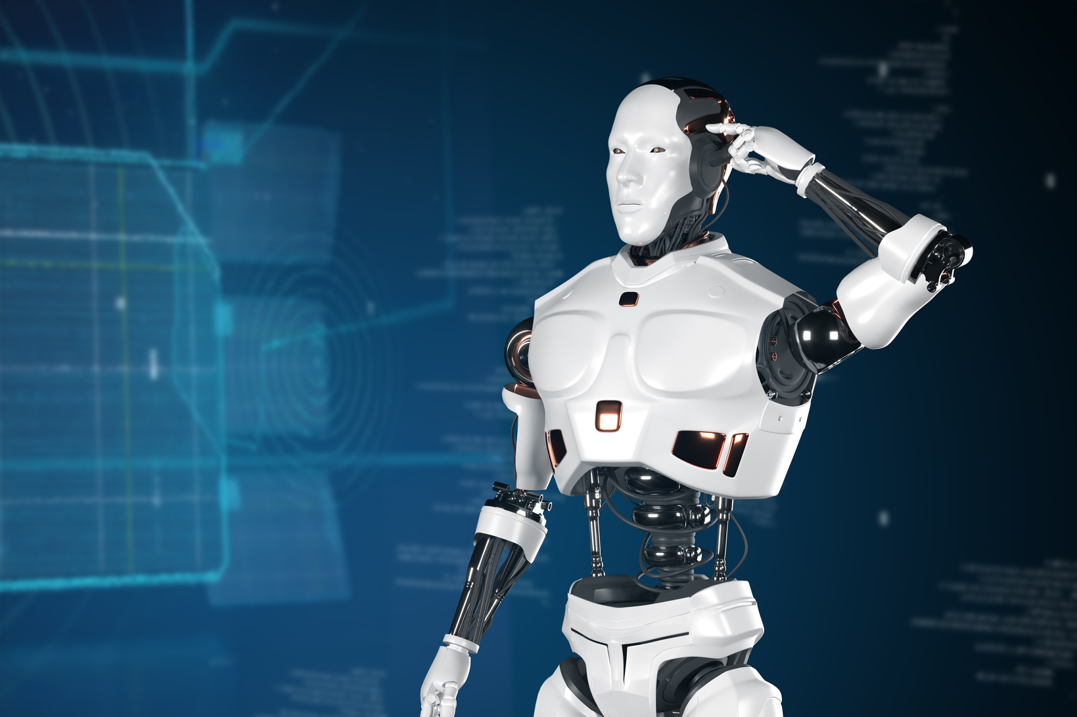
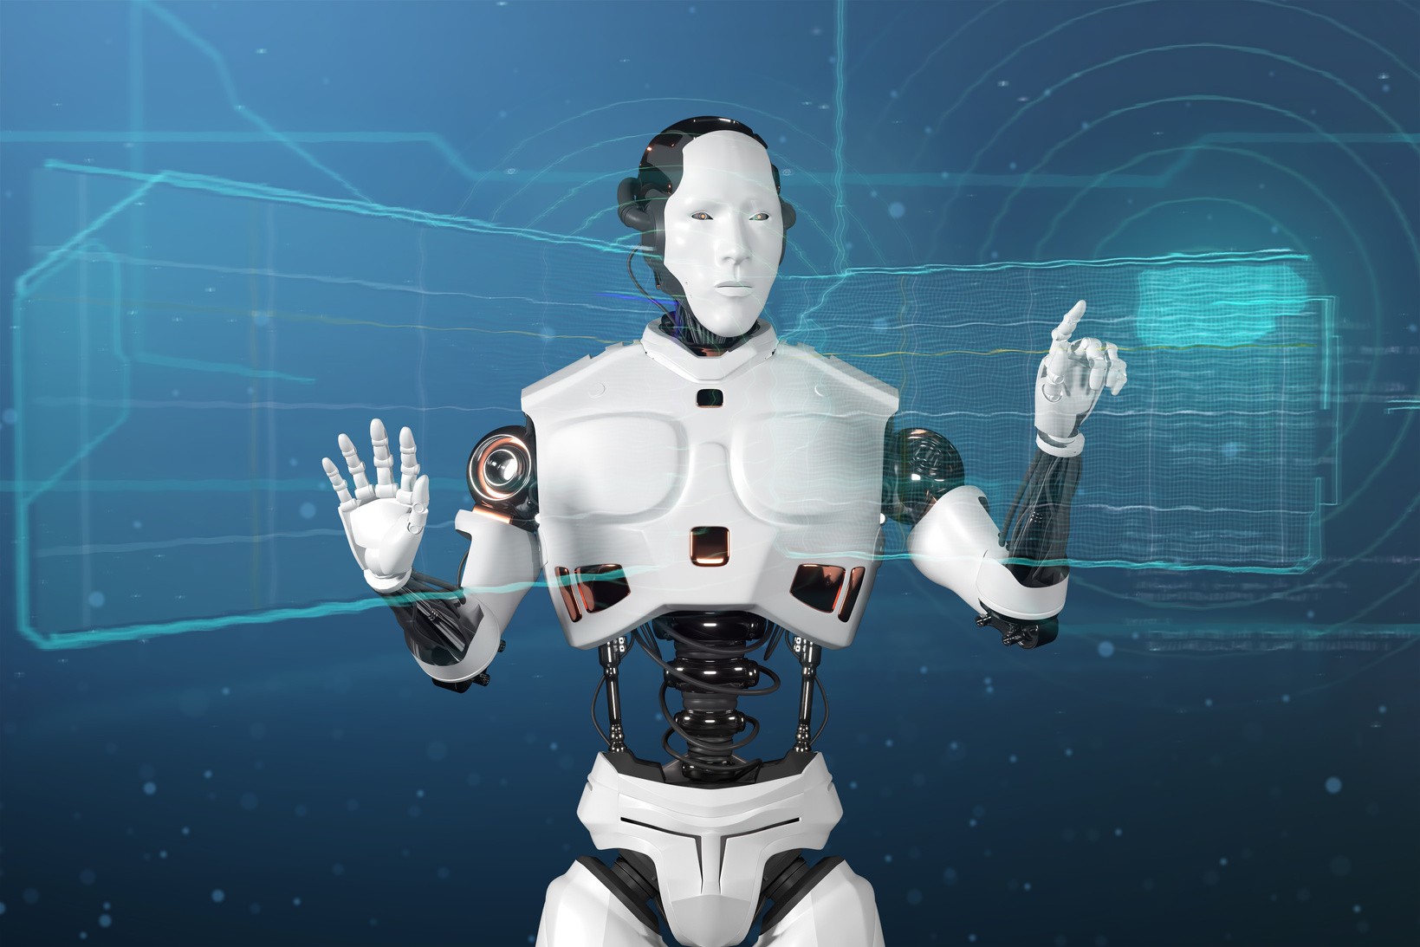
Smart Buy
Home
Service
About Us
Contact
Search . . . .
Our Mission
Our mission is to harness the power of Machine Learning to simplify complex decision-making processes in the automotive sector. By creating a reliable and accessible car price prediction platform, we aim to:
Empower Users: Enable buyers, sellers, and dealerships to make informed decisions with data-driven insights.
Promote Transparency: Reduce ambiguity in vehicle valuation through accurate and consistent predictions.
Drive Innovation: Leverage cutting-edge technology to bridge the gap between raw data and actionable intelligence.

Slide 7



Smart Buy
Home
Service
About Us
Contact
Search . . . .
Meet Our team
J CHAITANYA SAI
K SUMITH GOUD
ARNAV SAXENA

Slide 8
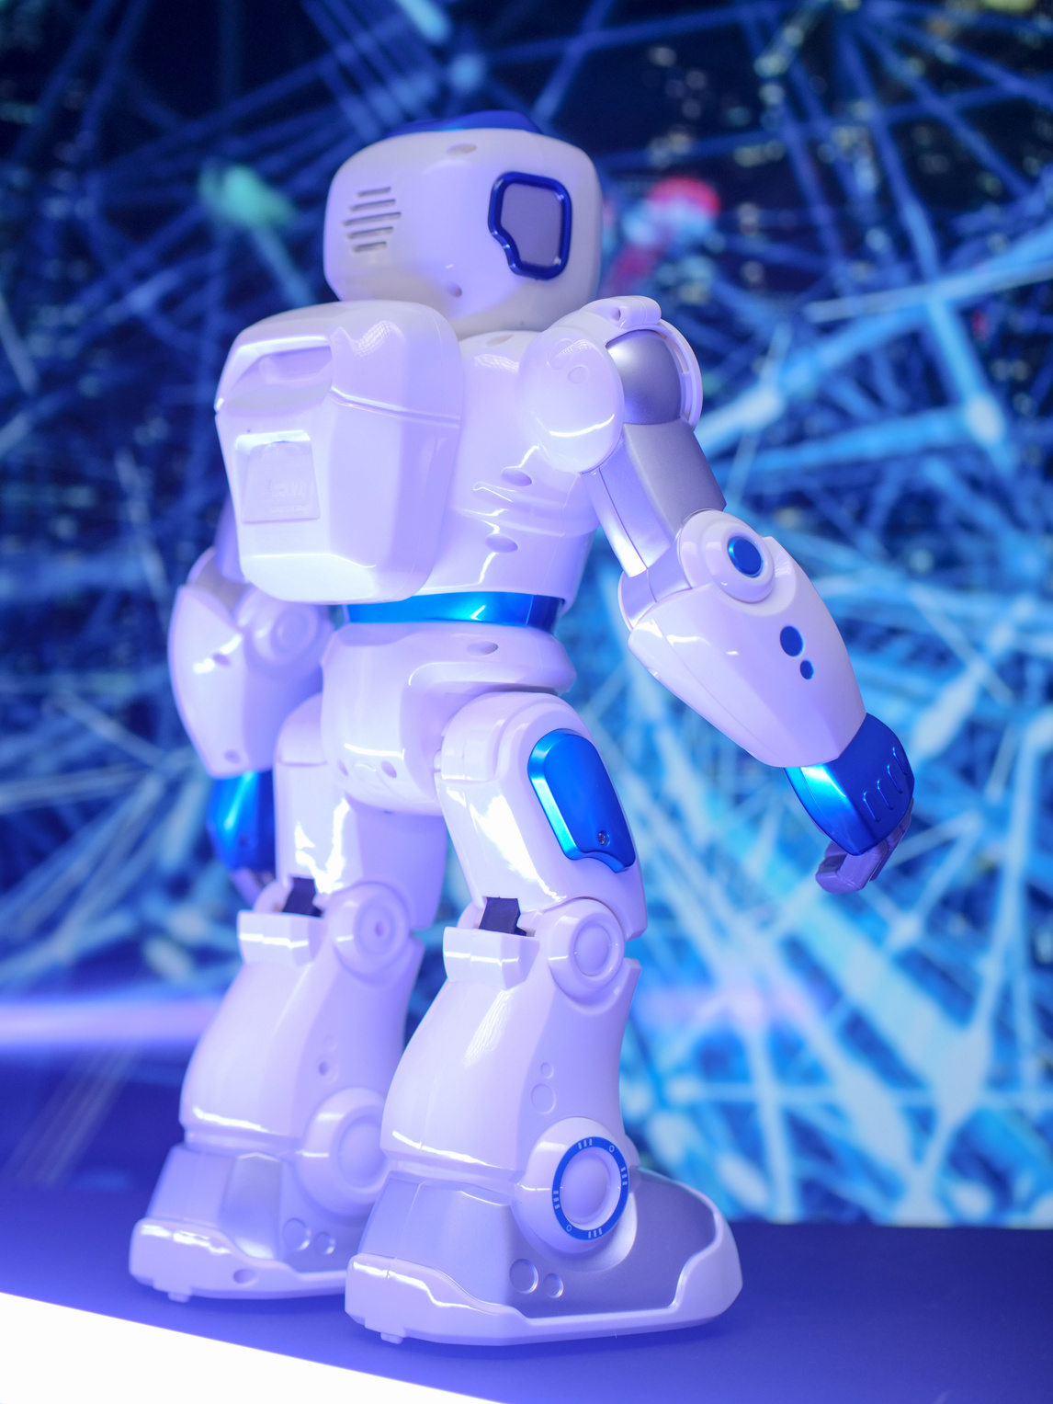
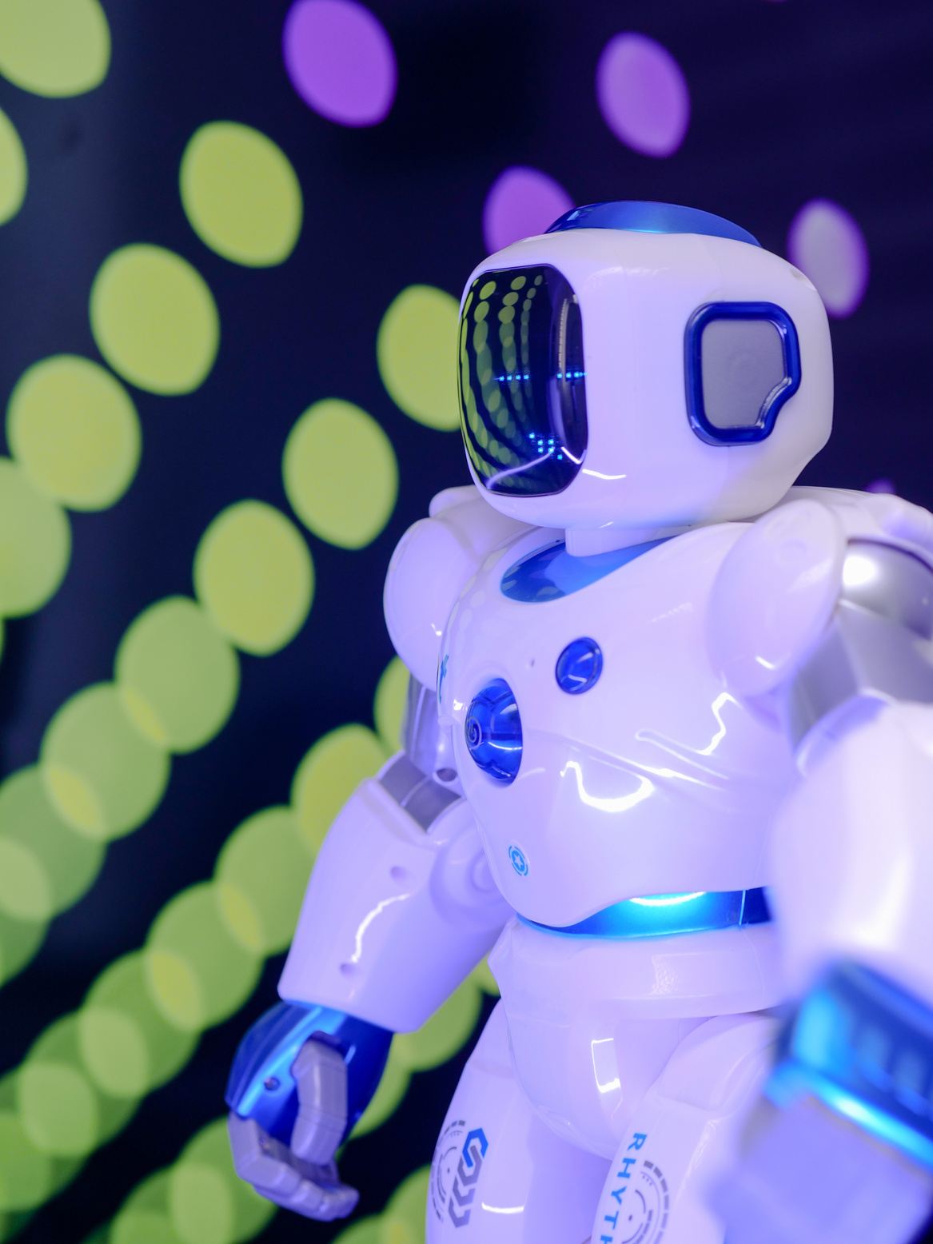
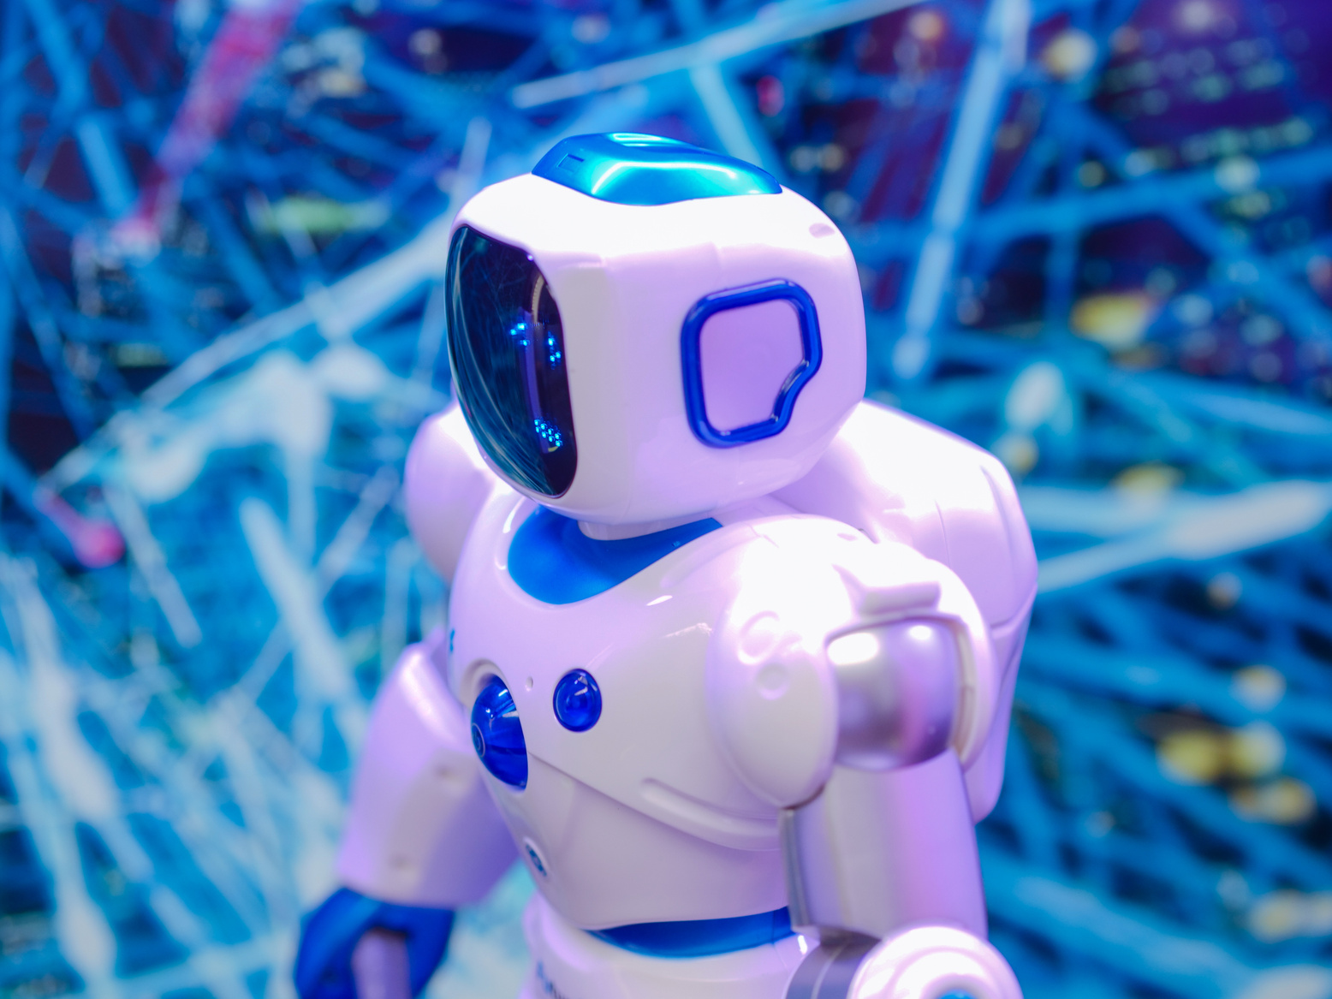




Smart Buy
Home
Service
About Us
Contact
Search . . . .
Contact Us
9032333138
www.smartbuy.com
e23cseu0618@bennett.edu.in
Bennett university, Greater Noida

Slide 9

Smart Buy
Home
Service
About Us
Contact
Search . . . .
Thank You

